Slide 1
Sorting:Worst to Best
By : Dev Kalra( 170001018 )
Nitesh Ahirwar ( 170004019 )

Slide 2
Overview
Sorting basically means putting things into order, depending upon some parameters. Sorting has lot of applications in almost every field from sorting a shopping list to Commercial computing to searching for some data, which requires sorting, numerical computations and so many other algorithms requires sorting of data
Here we implemented ,analyze and tried to improve the quick sort. So that its worst case complexity is less than O(n^2).

Slide 3
Approaches
Divide and conquer Programming: Quick sort making worst case as best.
Quicksort in not efficient for the worst cases, array in descending order or ascending order.
We will focus on this arrays and partitions and will try to make it efficient

Slide 4
Improvised Quick Sort: Algorithm
This algorithm is implemented using Divide and Conquer algorithm design approach.We have merged quick sort and insertion sort for better efficiency.

Slide 5
Quick Sort
QuickSort is a Divide and Conquer algorithm. It picks an element as pivot and partitions the given array around the picked pivot. There are many different versions of quickSort that pick pivot in different ways.
Always pick first element as pivot.
Always pick last element as pivot (implemented below)
Pick a random element as pivot.

Slide 6
Complexity Analysis
Best Case: k = n/2
T(n) = O(nlogn)
Worst Case: k = 0
T(n) = O(n^2)
Average Case: For some k
Showing that the average-case running time is also O(nlogn) takes some pretty involved mathematics, and so we won't go there.

Slide 7
Drawbacks of Quicksort Algorithm
The only drawback in using this algorithm is that it takes O(n^2) in the worst case

Slide 8
Improvised quicksort
We have merged two sorting algorithm,so when the total number of inputs are less than or equal to twenty we use insertion algorithm as it works better than quick sort for small number of inputs and for other we use modified quick sort.
We have used variables( i and j) and according to them we check if there is a Ascending or Descending pattern in our input.
There are two different sorting functions each for one pattern(either ascending or descending).

Slide 9
Complexity analysis
The time complexity for the improvised algorithm is far better than the quicksort in the worst case.
Worst Case is when the given array is in increasing or decreasing order our algorithm solves this in O(n).
It will not only check for the input array but also for the subarray made by the partition functions, And will return the sorted array in O(n) in this case.

Slide 10
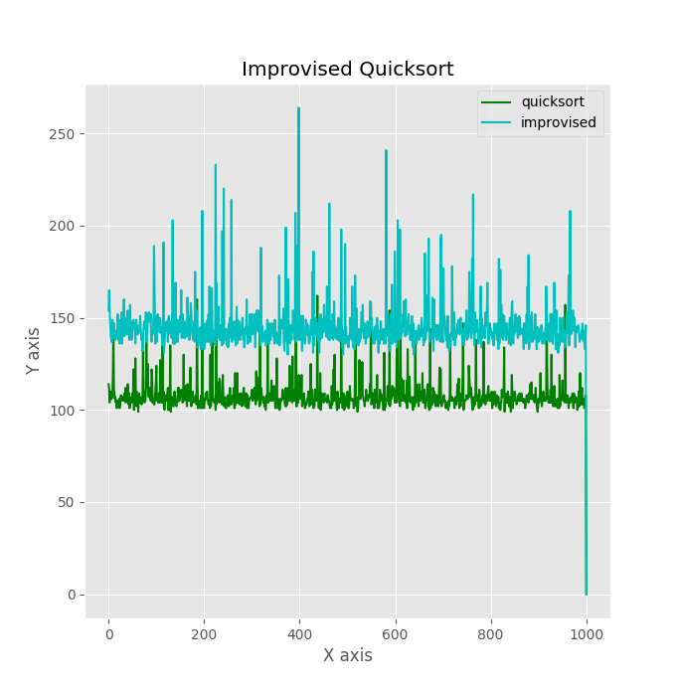

Slide 11
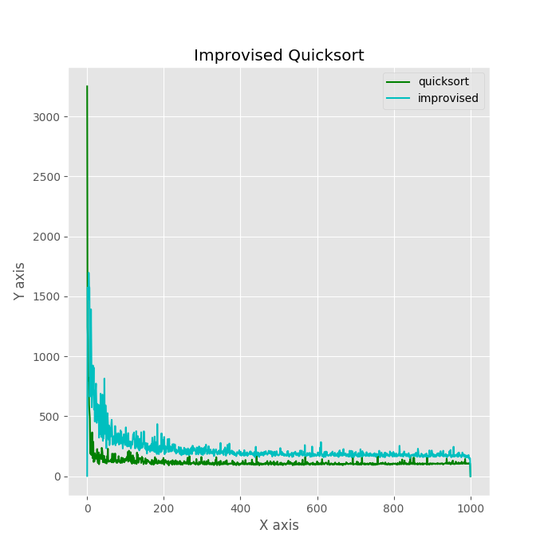

Slide 12
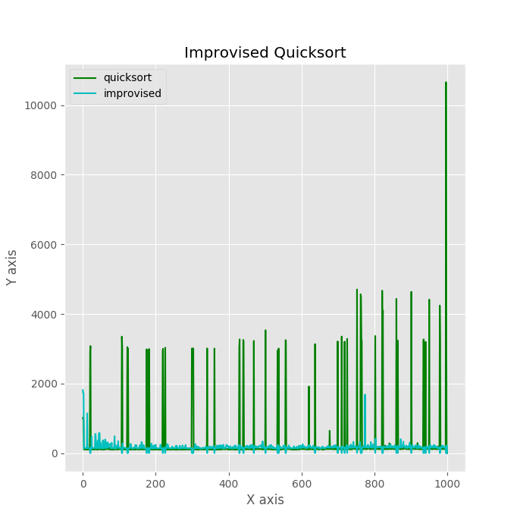

Slide 13
Disadvantages
To improve efficiency for the worst case we have to compromise a little for the time efficiency of a random or an average case.
Advantages
This algorithm improves the time complexity greatly in the worst case and can be seen in the following plottings.

Slide 14
Thank You !!

